Slide 1
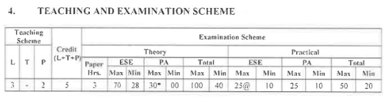
Basic Electronics
BEC 22225

Slide 2
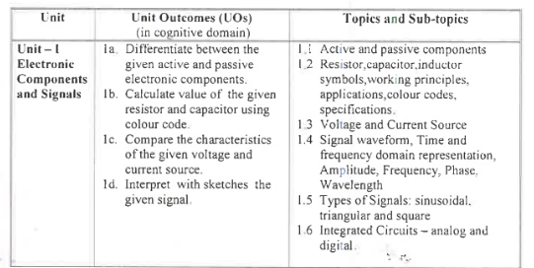

Slide 3
CHAPTER-1
Electronic Component and Signals
12MARKS

Slide 4
1. Electronic Component and Signals
Contents:
Active and passive components
Resistor,Inductor,Capacitor symbol, working principles application color code and specification.
Current voltage source.
Signal waveforms
Types of signal
Integrated circuits

Slide 5
Definition of electronics: Electronics is the branch of science that deals with the study of flow and control of electrons and the study of their behavior and effects in vacuums, gases, and semiconductors devices using electrons.

Slide 6
Applications of electronics in different fields:
Communication and Entertainment: a) Wire communication or Line communication. b) Wireless communication. The examples of wire communication are Telegraphy, Telephony, Telex and Teleprinter. The examples of wireless communication are radio broadcasting, TV broadcasting, and satellite communication.
2. Defense: The most important application is RADAR.
3. Industrial Applications: Electronic circuits are used to control thickness, quality, weight and moisture. They are also used to amplify weak signals.
4. Medical sciences: Electronics helps doctors and scientists in the diagnosis and treatment of various diseases. E.g. X-rays, ECG , Oscillography and Short-wave diathermy units.
5. Instrumentation: Instrumentation plays very vital role in research field and industry. E.g. Cathode Ray Oscilloscope (CRO), Frequency counter, Signal generator and Strain gauges

Slide 7
Types of Electronics Components: Active & Passive
Active Component: The electrical components which are capable of amplifying or processing electrical signals are called active components. Example: Diode, Transistor etc.
Passive Component: The electrical components which are not capable of amplifying or processing electrical signals are called passive components. Example: Inductor, Capacitor, Resistor etc.

Slide 8
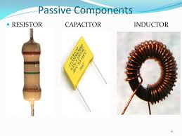
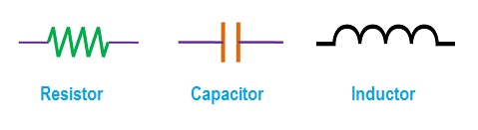

Slide 9
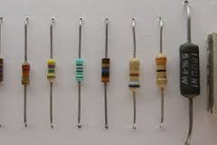
Definition of resistor: A resistor is an electrical component that limits or regulates the
flow of electrical current in an electronic circuit.

Slide 10
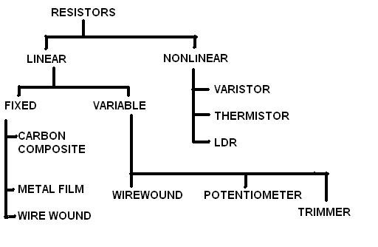

Slide 11
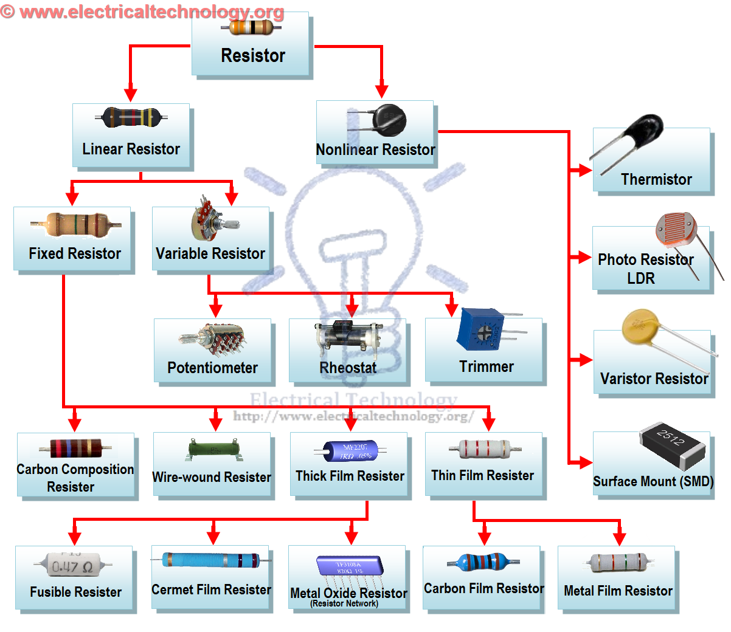

Slide 12
1. Linear Resistors:
Those resistors, which values change with the applied voltage and temperature, are called linear resistors. In other words, a resistor, which current value is directly proportional to the applied voltage Is known as linear resistors.
2.Non Linear Resistor- nonlinear resistors are those resistors, where the current flowing through it does not change according to Ohm’s Law but, changes with change in temperature or applied voltage.
1.Thermisters 2.Varisters(VDR) 3. Photo Resistor or Photo Conductive Cell or LDR

Slide 13

4 -band Resistor Color Code

Slide 14
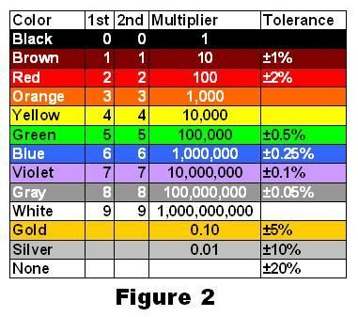
The coloured bands are shown as: YELLOW , VIOLET, ORANGE and GOLD. Then the resistance using the colour table is found as:

Slide 15
The first colour band (yellow) gives the first digit value of 4.
The second colour band (violet) gives the second digit value of 7.
This gives a two digit value of 47.
Multiply this by the value of the third band.
In this case, orange which has a value of 1000 or 1k, so the resistor has a resistive value of 47,000 ohms (47 × 1000 = 47000) or 47kΩ’s.
The last band gives the resistors tolerance value and gold equals a tolerance range of ±5%.
Then using the resistor colour wheel, the resistor has the following resistance:
Yellow Violet Orange = 4 7 3 = 4 7 x 10³ = 47000Ω or 47kΩ ±5%.

Slide 16
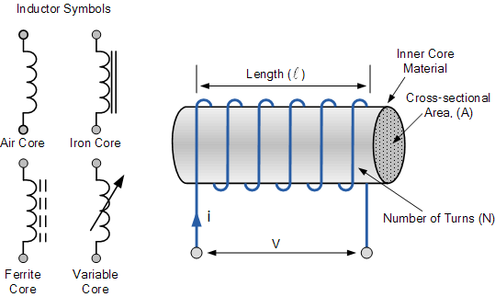
INDUCTOR –It is an electrical conductor that “opposes a change in the current”, Inductance which is given the symbol L with units of Henry, (H)

Slide 17
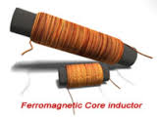
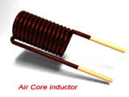

Slide 18
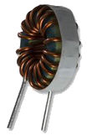
Specifications of inductor:
Inductance value
Q factor
3) Operating frequency range
4) Power dissipation
5) Core
6) Size and mounting requirements
7) Stary capacitance

Slide 19
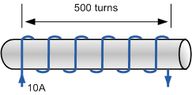

Inductance of a Coil

Slide 20

Self Inductance of a Coil
Where:
L is in Henries
N is the Number of Turns
Φ is the Magnetic Flux Linkage
Ι is in Amperes

Slide 21

Therefore value = 27 x10 = 270µH +/-20%

Slide 22
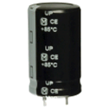
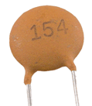
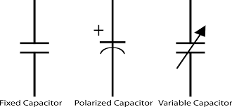
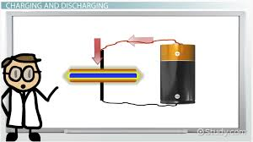
Capacitor-is a simple passive component that is used to “store electricity”.

Slide 23
By applying a voltage to a capacitor and measuring the charge on the plates, the ratio of the charge Q to the voltage V will give the capacitance value of the capacitor and is therefore given as
C = Q/V

Slide 24
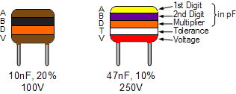

Slide 25
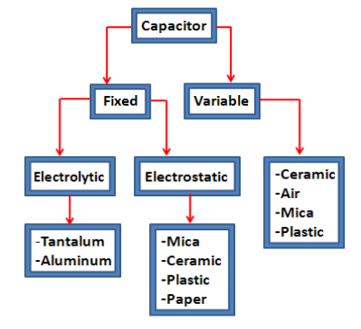

Slide 26
Signal
Signals is physical quantity which contains variables information.
The signal is defined as any physical quantity that varies with time, frequency or any other independent variables.
Examples: Motion, sound, picture, video, traffic light…
Notes:
Natural Systems: These are systems like the ecosystem, blood system and solar system.
Human-made System: These systems include not designed and designed physical systems such as: machines, industrial plants, telecomunication infrastructure networks, computer storage systems and modern sculptures.
Abstract Systems: Every conceptual model is an abstract system, for example, traffic system models and computer programs are both types of modeled systems. They can be the product of identification, design or invention.
Descriptive and Normative Systems: They relates to human and other living system activity, an example of these are; plans, bus/train timetable, ethical systems.

Slide 27
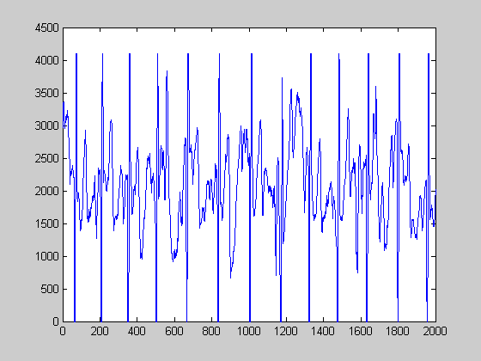
Signal Examples
Electrical signals
Acoustic signals
Video signals
Biological signals
Noise: unwanted signal

Slide 28
Electrical Signal
The dynamic signal representing electrical quantity either voltage or current is known as electrical signal.
Types of electrical signal:
1)Analog Signal
2) Digital signal

Slide 29
Analog signal
Signal having continuous values.
They can have infinite number of different values.
Ex: temperature, pressure, distance, sound.
AM, FM for voice sound
Traditional TV for analog video
First generation cellular phone (analog mode)

Slide 30
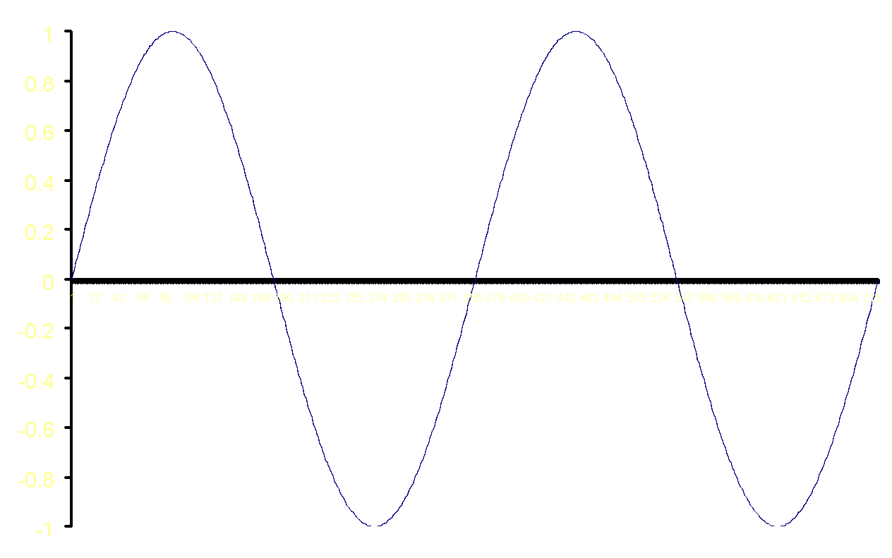
Analog signal
Amplitude
Period

Slide 31



Analog Signals
Human Voice – best example
Ear recognises sounds 20KHz or less
AM Radio – 535KHz to 1605KHz
FM Radio – 88MHz to 108MHz

Slide 32
Analog Signals:
Advantages:
major advantages of the analog signal is infinite amount of data.
Density is much higher.
easy processing.
Disadvantages:
Unwanted noise in recording.
If we transmit data at long distance then unwanted disturbance is there.
Generation loss is also a big con of analog signals.

Slide 33
Digital signal
Signal having finite number of distinct value.
Not continuous signal.
Discrete signal.
Ex: binary, octal
2G/3G cellular phone
Data on your disk

Slide 34
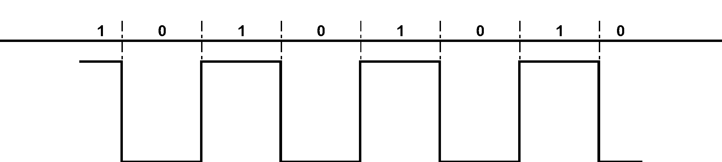
Digital signal

Slide 35
Digital Signals:
Advantages:
Because of their digital nature they can travel faster in over digital lines.
Ability to transfer more data as compared to analog.
Disadvantages:
Greater bandwidth is essential.
Systems and processing is more complex.

Slide 36
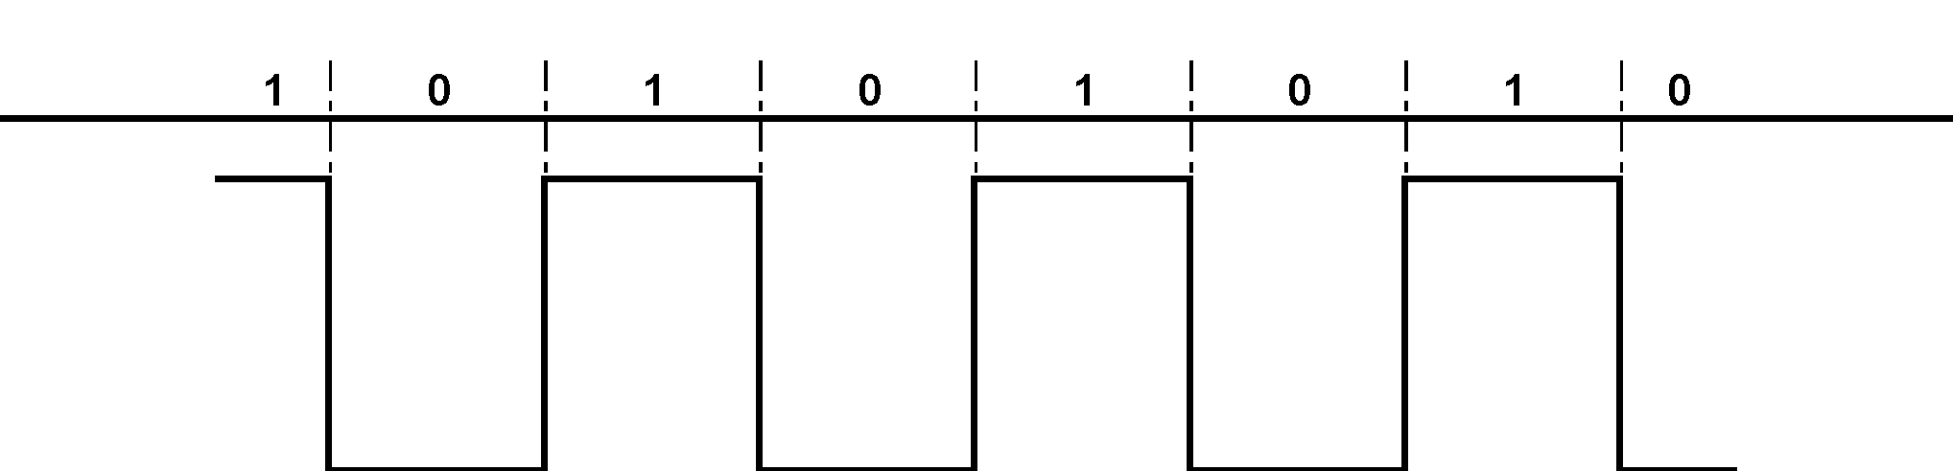
Digital signals
Represented by Square Wave
All data represented by binary values
Single Binary Digit – Bit
Transmission of contiguous group of bits is a bit stream
Not all decimal values can be represented by binary

Slide 37
Analogue vs. Digital
Analogue Advantages
Best suited for audio and video
Consume less bandwidth
Available world wide
Less susceptible to noise
Digital Advantages
Best for computer data
Can be easily compressed
Can be encrypted
Equipment is more common and less expensive
Can provide better clarity

Slide 38
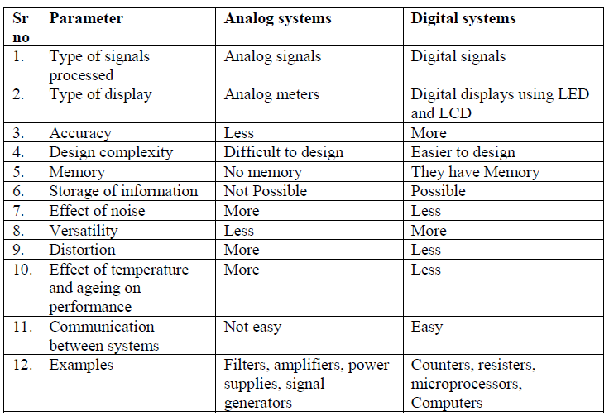
comparison

Slide 39
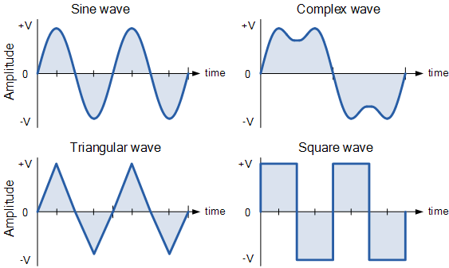
TYPES ANALOG SIGNALS

Slide 40
The Period, (T) is the length of time in seconds that the waveform takes to repeat itself from start to finish. This can also be called the Periodic Time of the waveform for sine waves, or the Pulse Width for square waves.
• The Frequency, (ƒ) is the number of times the waveform repeats itself within a one second time period. Frequency is the reciprocal of the time period, ( ƒ = 1/T ) with the unit of frequency being the Hertz, (Hz).
• The Amplitude (A) is the magnitude or intensity of the signal waveform measured in volts or amps.
Wavelength (λ) The distance between two consecutive crests or troughs is called wavelength(λ)

Slide 41
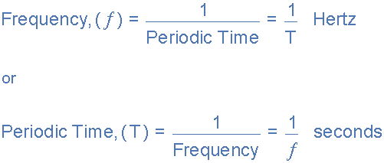
Relationship Between Frequency and Periodic Time

Slide 42
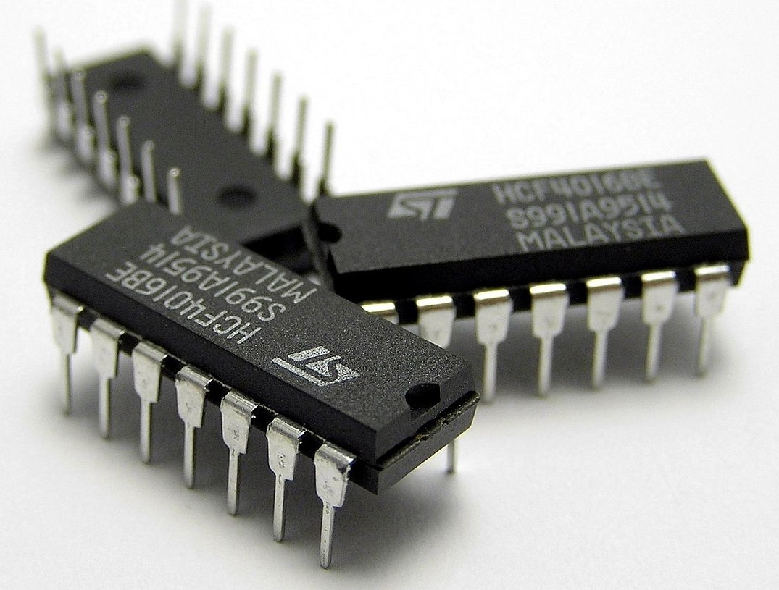
Integrated Circuits

Slide 43
Integrated Circuits
An integrated circuit is electronic circuit consisting of active & passive components that are joined together on a single small crystal chip of semiconductor material, usually silicon or on a single insulating substrate such as, glass, ceramic .

Slide 44
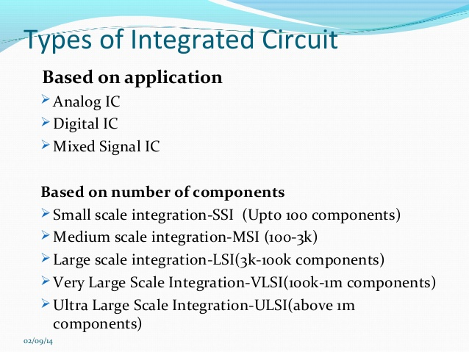

Slide 45
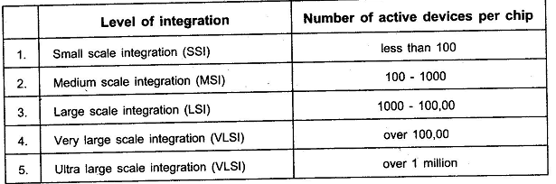

Slide 46
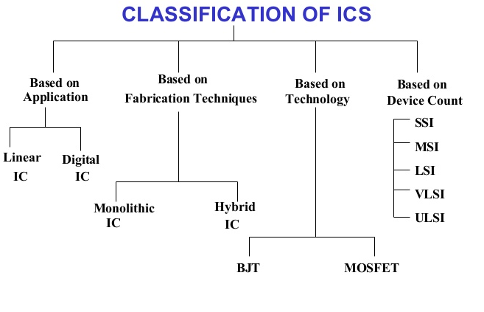

Slide 47
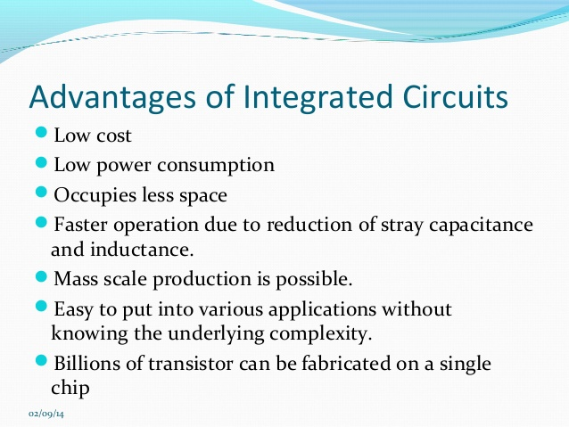

Slide 48
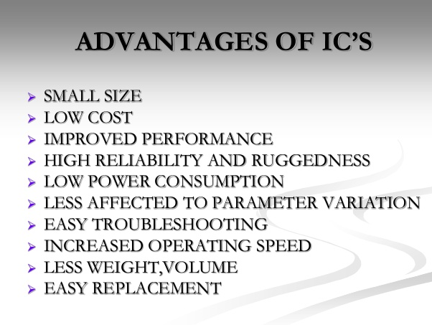

Slide 49
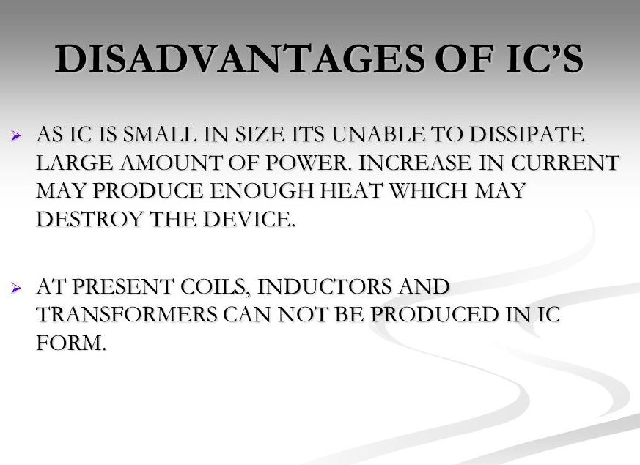

Slide 50
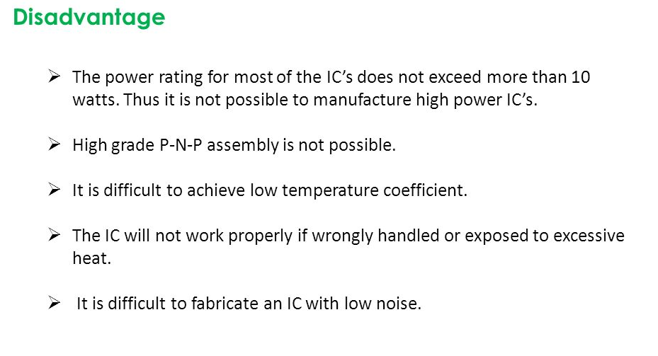

Slide 51
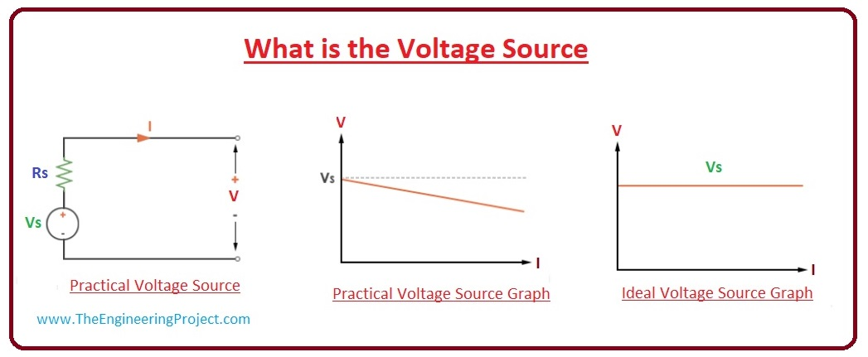
Ideal and Practical Voltage Source
A voltage source is a two-terminal device whose voltage at any instant of time is constant and is independent of the current drawn from it.
Such a voltage source is called an Ideal Voltage Source and have zero internal resistance
Sources having some amount of internal resistances are known as Practical Voltage Source.

Slide 52
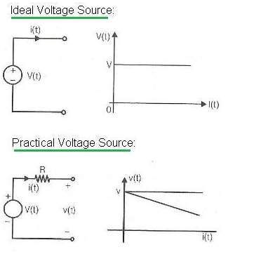
V-I Characteristics

